Slide 1


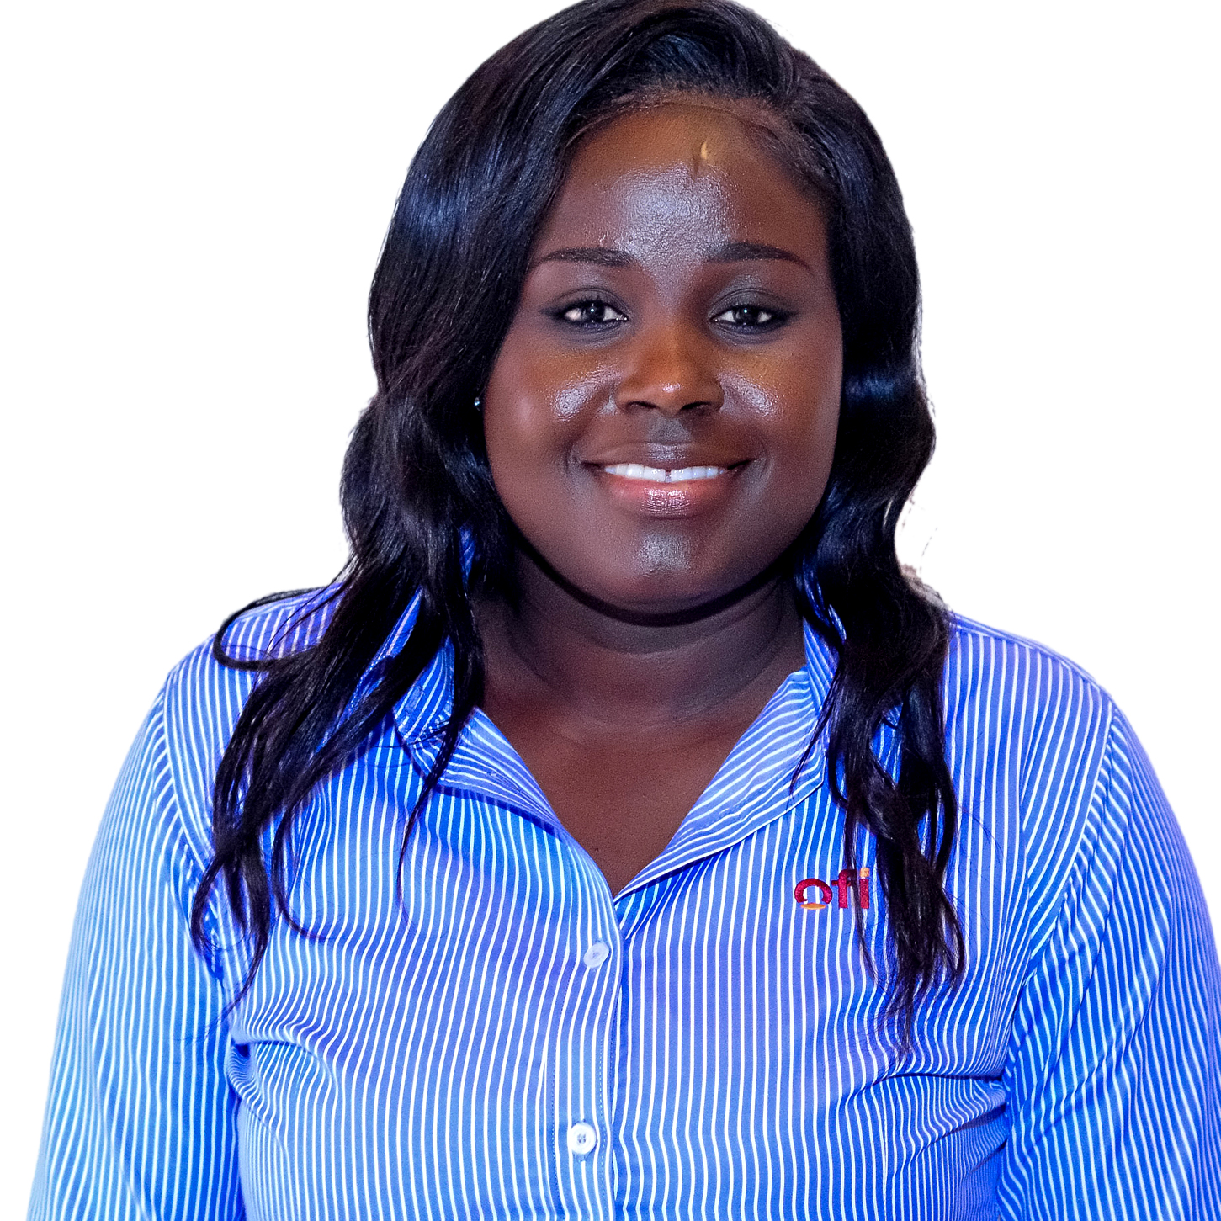
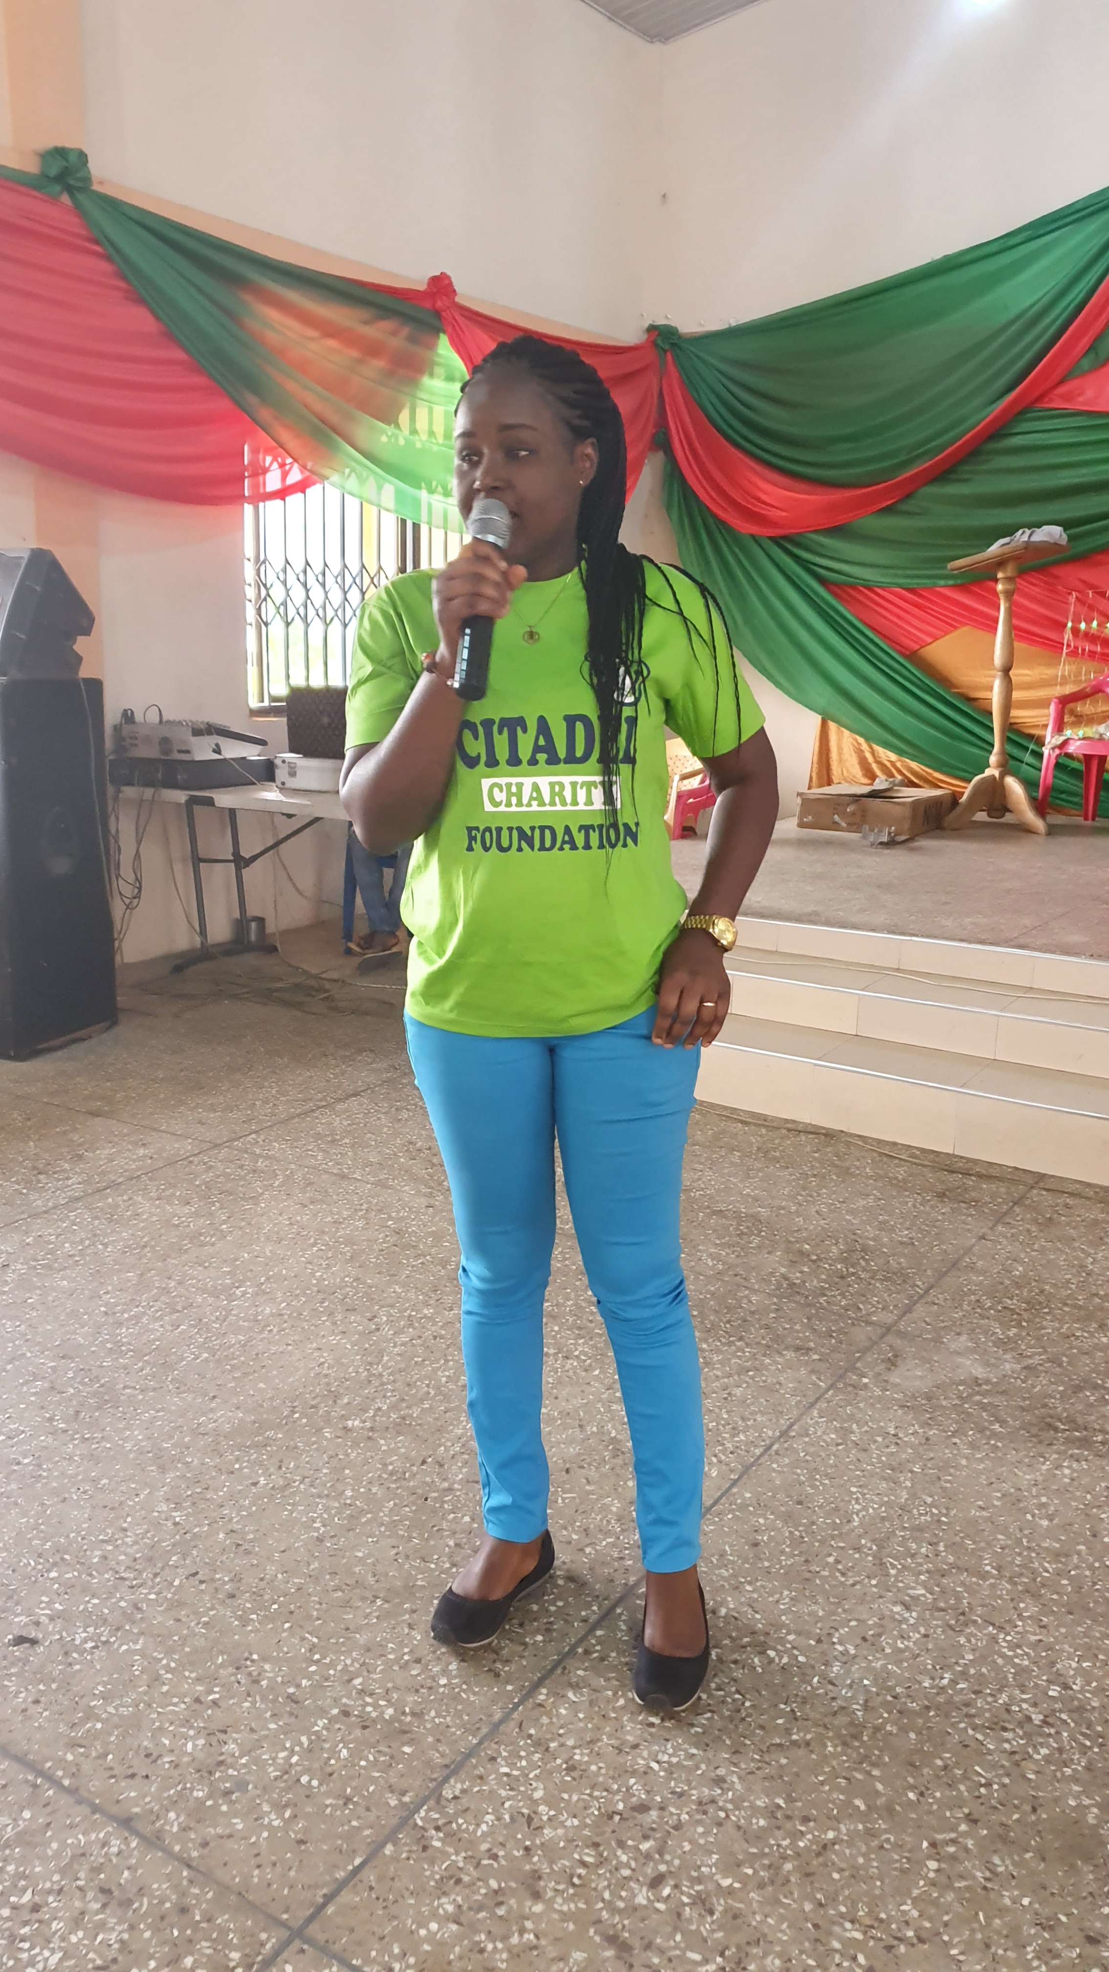
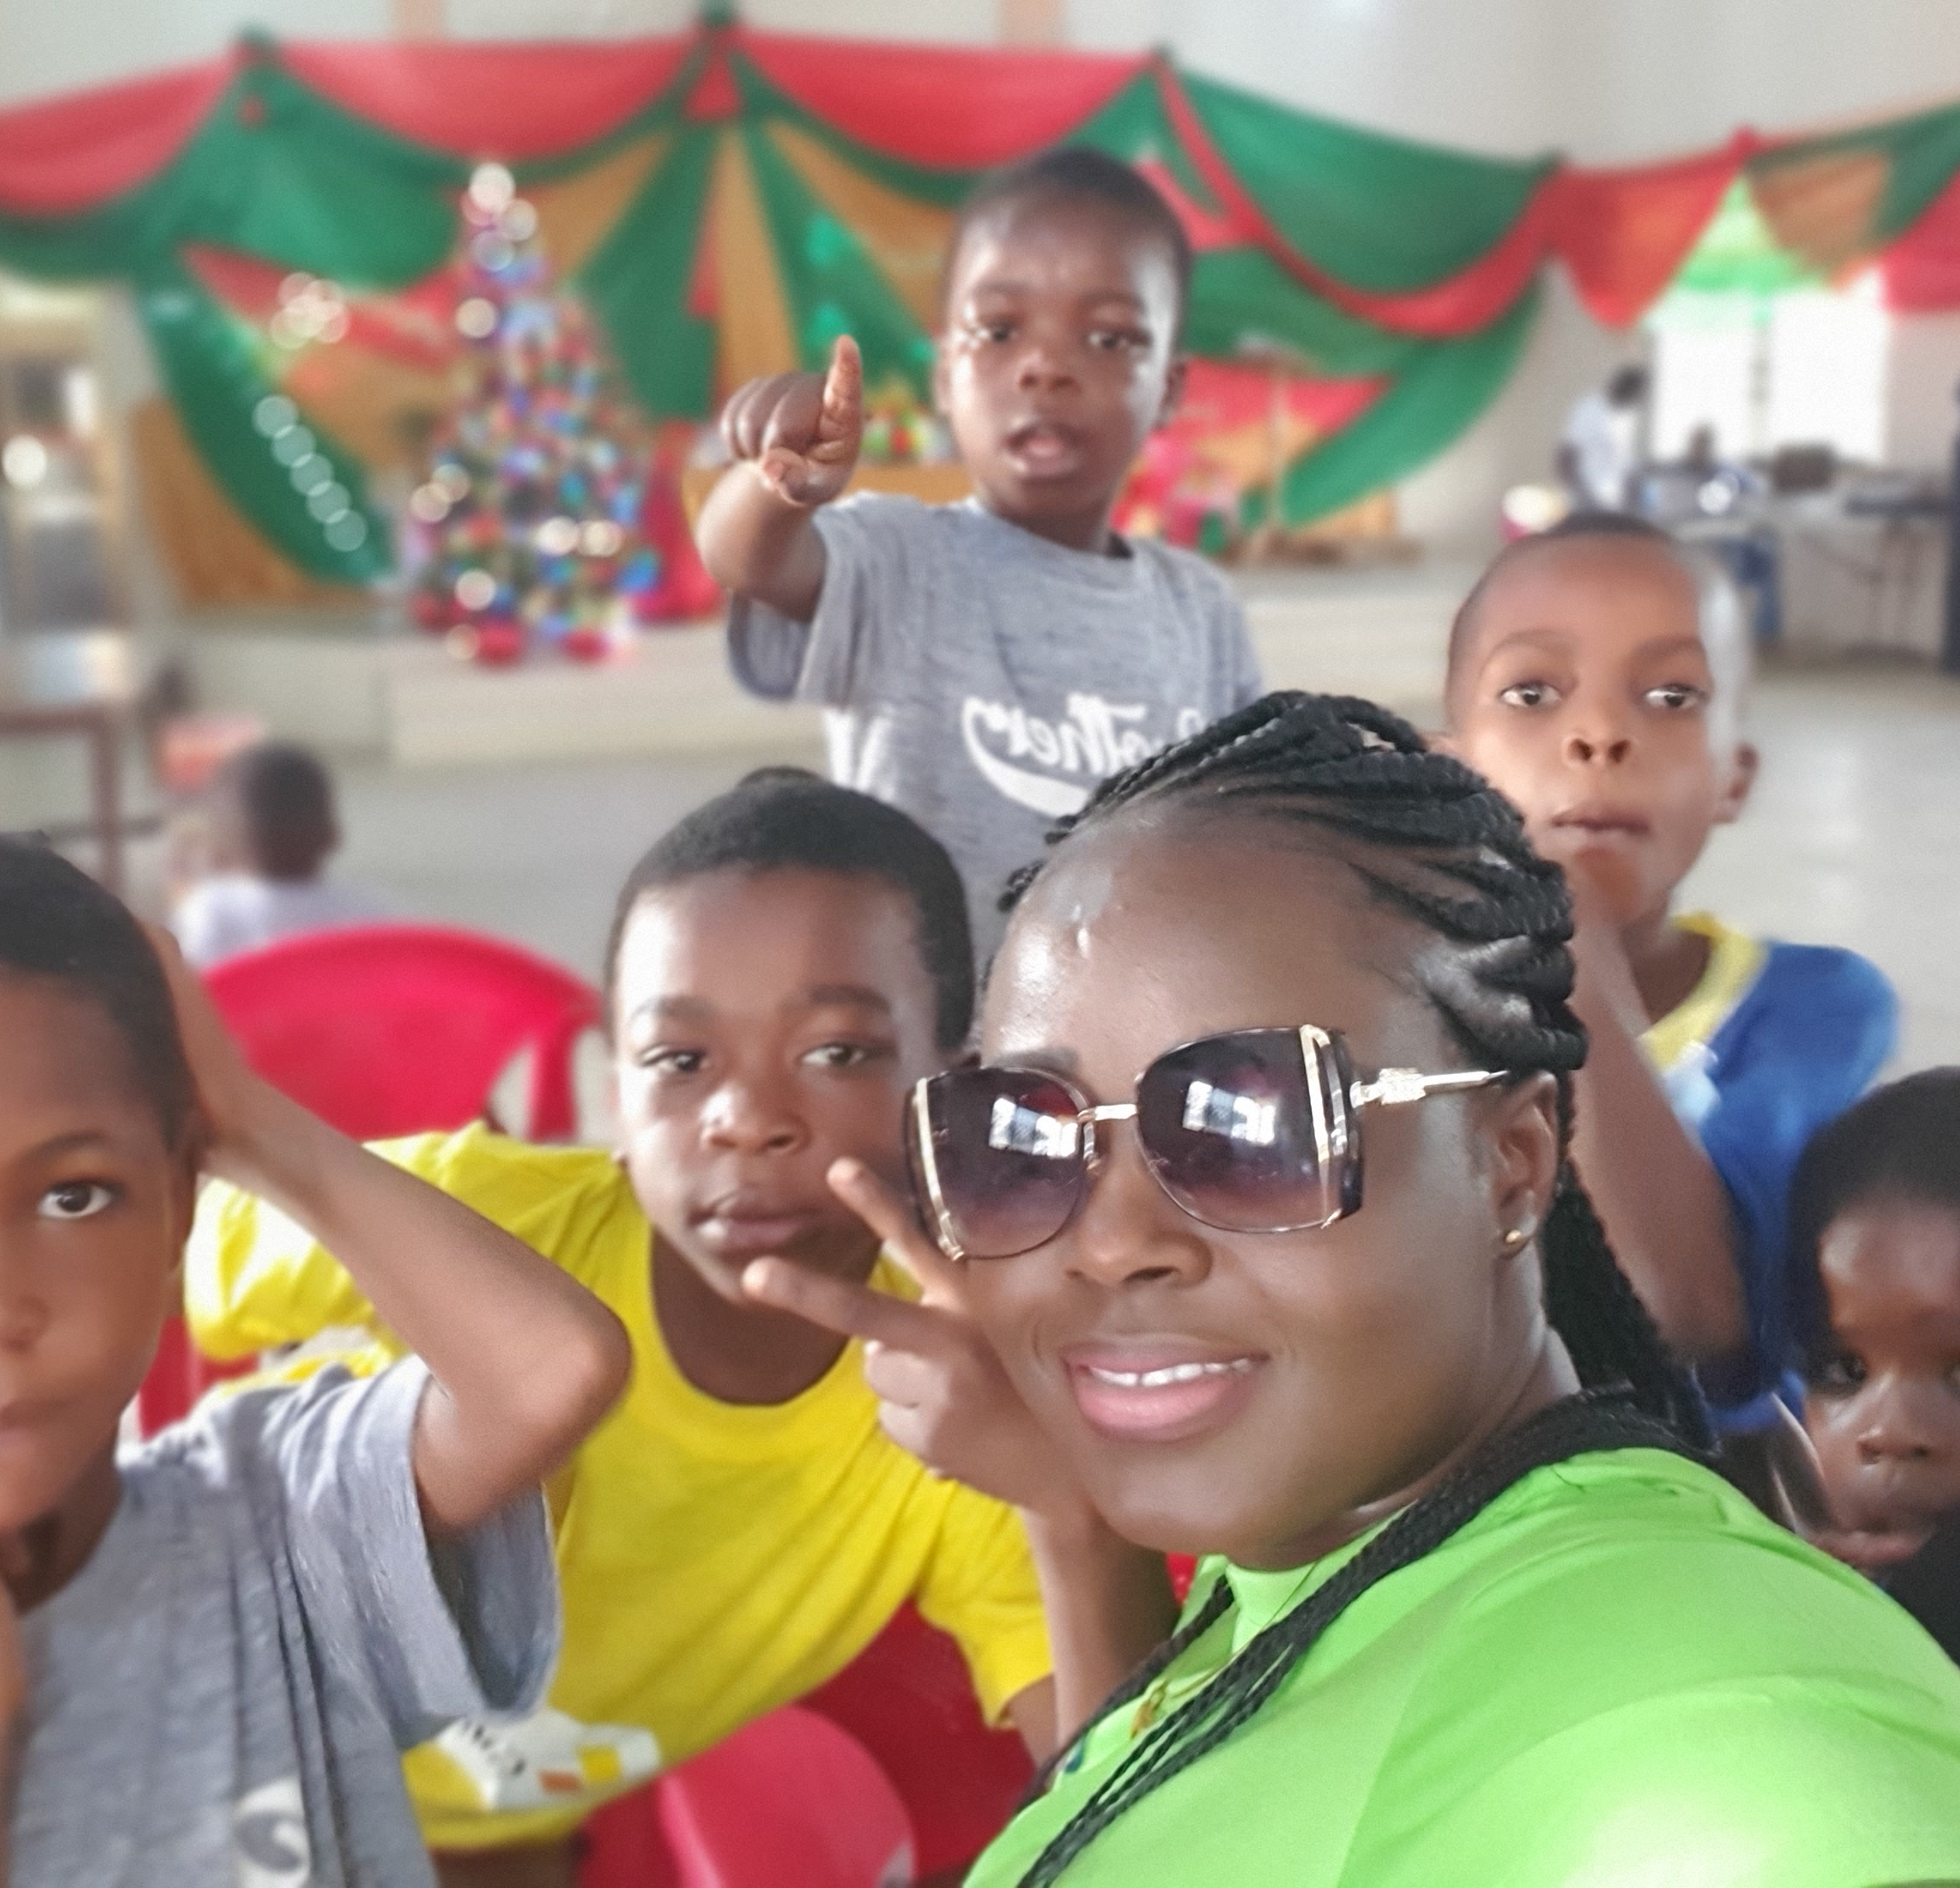
Getting to Know Me
Work
Personal
My role
Regional Quality Manager(Cocoa)- Africa
Significant others / family members / furry friends in my life
Husband/Children
Tenure in ofi/Olam
16 years
How I enjoy spending my free time
With my family
Previous companies I have worked at
Komfo Anokye Teaching Hospital(KATH), ADM Cocoa
My favorite / comfort food
Ampesi with Palava Sauce
Why I joined ofi/Olam and what keeps me here?
Growth Opportunities and being able to make meaningful Impact
My favorite song
Heal The World
Celestina Amoa-Menyah
‘I prefer to be called Celestina’
A few fun facts about me
Always Calm in Chaos
Unique gift of inspiring people to achieve more than they thought possible
This is me outside work, doing stuff I enjoy in my life …

